Slide 1

Introduction to Python Programming
List
Ms. Shital H. Dinde

Slide 2
List
Lists are ordered collection of different kinds of data items.
They store multiple items in a single variable.
List items are separated by commas and enclosed within square brackets [].
Lists are changeable meaning we can alter them after creation. (Mutable)
The list element can be accessed via the index.

Slide 3
Example
lst1 = [1,2,2,3,5,4,6]
lst2 = ["Red", "Green", "Blue"]
print(lst1)
print(lst2)
details = ["Abhijeet", 20, "TYCS", 9.8]
print(details)

Slide 4

List index
Each item/element in a list has its own unique index.
This index can be used to access any particular item from the list.
The first item has index [0], second item has index [1], third item has index [2] and so on.

Slide 5
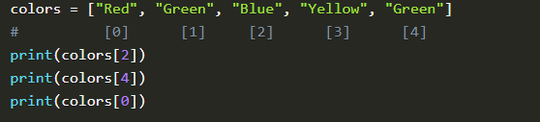
Accessing list items
Positive Indexing: As we have seen that list items have index, as such we can access items using these indexes.

Slide 6
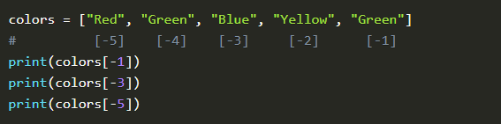
Negative Indexing : Similar to positive indexing, negative indexing is also used to access items, but from the end of the list. The last item has index [-1], second last item has index [-2], third last item has index [-3] and so on.

Slide 7
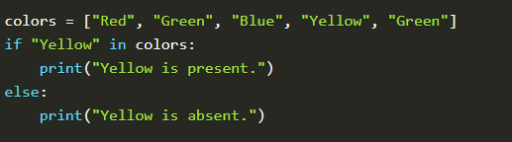
Check for item : check if a given item is present in the list. This is done using the in keyword

Slide 8
Range of Index/Slicing: print a range of list items by specifying where do you want to start, where do you want to end and if you want to skip elements in between the range
Syntax:
List[start : end : jumpIndex]
jumpIndex is optional.

Slide 9

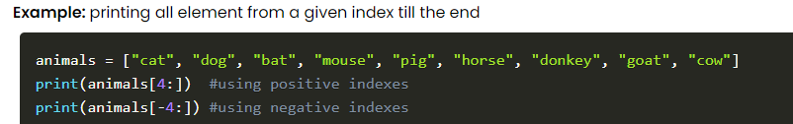
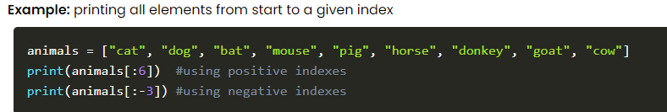

Slide 10
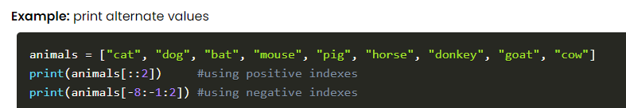

Slide 11
Add List Items
There are three methods to add items to list: append(), insert() and extend()
append() : This method appends items to the end of the existing list
insert(): This method inserts an item at the given index. User has to specify index and the item to be inserted within the insert() method.
extend(): This method adds an entire list or any other collection datatype (set, tuple, dictionary) to the existing list.

Slide 12
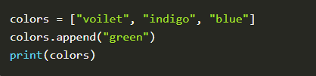
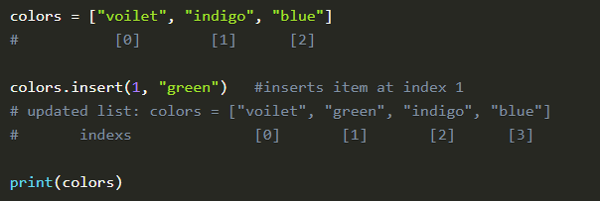
Append
Insert

Slide 13

concatenate two lists

Slide 14
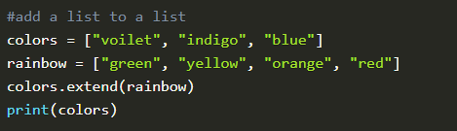
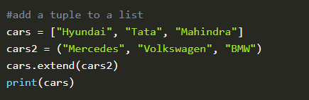
Extend

Slide 15
Remove List Items
There are various methods to remove items from the list:
pop(): This method removes the last item of the list if no index is provided. If an index is provided, then it removes item at that specified index.
remove() : This method removes specific item from the list.
del: del is not a method, rather it is a keyword which deletes item at specific from the list, or deletes the list entirely.
clear(): This method clears all items in the list and prints an empty list.

Slide 16



Pop
Remove

Slide 17



Del
Clear

Slide 18


Change List Items
Changing items from list is easier, you just have to specify the index where you want to replace the item with existing item

Slide 19
List Methods
sort(): This method sorts the list in ascending order.
We must give reverse=True as a parameter in the sort method to sort in descending order.
index(): This method returns the index of the first occurrence of the list item.
count(): Returns the count of the number of items with the given value.
copy(): Returns copy of the list. This can be done to perform operations on the list without modifying the original list.

Slide 20
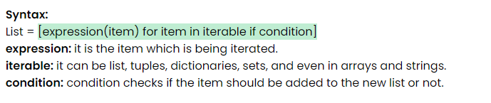
List Comprehension
List comprehensions are used for creating new lists from other iterables like lists, tuples, dictionaries, sets, and even in arrays and strings.

Slide 21



Slide 22
Write a function sumprimes(l) that takes as input a list of integers l and retuns the sum of all the prime numbers in l.
A list rotation consists of taking the first element and moving it to the end. For instance, if we rotate the list [1,2,3,4,5], we get [2,3,4,5,1]. If we rotate it again, we get [3,4,5,1,2].
Write a Python function rotatelist(l,k) that takes a list l and a positive integer k and returns the list l after k rotations. If k is not positive, your function should return l unchanged. Note that your function should not change l itself, and should return the rotated list.

Slide 23


Questions?

Slide 24

8888 763 563
88 5335 4141
https://svlautomations.in
https://svltrainings.in

